Slide 1
Topic 8: Inspections, Analytics & Models (Part 3)
SECV2113 Human-Computer Interaction
Faculty of Computing
Universiti Teknologi Malaysia

Slide 2
INSPECTION: HEURISTIC EVALUATION
01
INSPECTION: WALK-THROUGHS
02
ANALYTICS AND A/B TESTING
03
PREDICTIVE MODELS
04

Slide 3
No Direct Involvement of Users
The evaluation methods described in previous topics involved users
The methods described in this topic do not directly involve users
These methods are based on an understanding of users’ behaviour but users are not directly involved
Three types of methods are discussed:
  Knowledge codified in heuristics
  Data collected remotely
  Models that predict people’s performance

Slide 4
INSPECTION:
HEURISTIC EVALUATION

Slide 5
Inspections: Heuristic Evaluation & Walkthroughs
Several kinds
Experts or researchers use their knowledge of people and technology to review software usability
Critiques can be formal or informal
Heuristic evaluation is a review guided by a set of heuristics
Walkthroughs involve stepping through a pre-planned scenario noting potential problems

Slide 6
Heuristic Evaluation
Developed by Jacob Nielsen in the early 1990s
Based on heuristics distilled from an empirical analysis of 249 usability problems
These heuristics have been revised for current technology by Nielsen and others for:
  Mobile devices
  Wearables
  Virtual worlds
  Social media
  Other types of systems
Design guidelines often form a basis for developing heuristics

Slide 7
Revised Version (2014) of Nielsen’s Original Heuristics
Visibility of system status
Match between system and real world
User control and freedom
Consistency and standards
Error prevention
Recognition rather than recall
Flexibility and efficiency
Aesthestic and minimalist design
Support error recovery
Provide help and documentation

Slide 8
No of Evaluators and Problems
Curve showing the proportion of usability problems in an interface found by heuristic evaluation using different numbers of evaluators
Source: Nielsen and Mack, 1994. Courtesy of Wiley.

Slide 9
No of Evaluators
Nielsen suggests that on average 5 evaluators identify 75-80 % of usability problems
This often depends on the context or type of application (Cockton & Woolrych, 2001)
Also depends on the skills and experience of the evaluators

Slide 10
Heuristics for Websites Focus on Key Criteria
Ensure website is designed for people who will use it
Clarity - avoid jargon, be concise & clear
Minimise unnecessary complexity & reduce cognitive load
Provide users with context – clear name & statement of purpose
Promote positive & pleasurable experience

Slide 11
Heuristics for UI Design based on Gestalt Principles
Simplicity
Proximity
Enclosure
Continuation
Figure and Ground

Slide 12
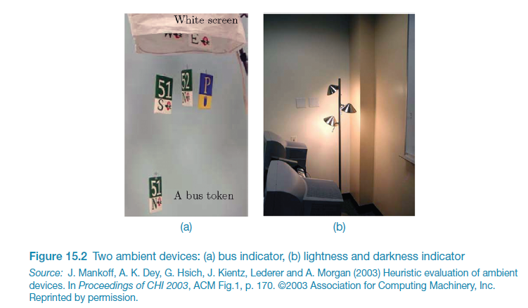
Heuristics for Ambient Displays

Slide 13
Doing Heuristic Evaluation
Briefing session to tell evaluators what to do
Evaluation period of 1-2 hours in which:
  Each evaluator works separately
  Take one pass to get a feel for the product
  Take a second pass to focus on specific features
Debriefing session in which evaluators work together to prioritize problems

Slide 14
Severity Ratings in Heuristic Evaluation
Severity ratings can be used to allocate the most resources to fix the most serious problems and can also provide a rough estimate of the need for additional usability efforts.
If the severity ratings indicate that several disastrous usability problems remain in an interface, it will probably be inadvisable to release it.
But one might decide to go ahead with the release of a system with several usability problems if they are all judged as being cosmetic in nature.
Source: https://www.nngroup.com/articles/how-to-rate-the-severity-of-usability-problems/

Slide 15
Contributing factors to a problem
The severity of a usability problem is a combination of three factors:
The frequency with which the problem occurs: Is it common or rare?
The impact of the problem if it occurs: Will it be easy or difficult for the users to overcome?
The persistence of the problem: Is it a one-time problem that users can overcome once they know about it or will users repeatedly be bothered by the problem?
If a problem has most of these factors, it should be rated more severe
Source: https://www.nngroup.com/articles/how-to-rate-the-severity-of-usability-problems/

Slide 16
Severity Rating Scale
Nielsen (1994) proposed the following 0 to 4 rating scale to rate the severity of usability problems:
0 = I don't agree that this is a usability problem at all
1 = Cosmetic problem only: need not be fixed unless extra time is available on project
2 = Minor usability problem: fixing this should be given low priority
3 = Major usability problem: important to fix, so should be given high priority
4 = Usability catastrophe: imperative to fix this before product can be released

Slide 17
Severity Rating Scale (cont.)
Barnum, C. (2011) proposed a 3-point severity rating scale:
1 = Catastrophe—user cannot complete task; or user can complete the process but expresses extreme irritation at the process; or user needs assistance (business goal is to make the process independent of user assistance).
2 = Serious problem—user is frustrated but gets through it; suggests that others may be less inclined to put up with the inconvenience or that frustration level will be high.
3 = Cosmetic problem—user may hesitate or pick the wrong option, but user corrects it without incident; or user expresses minor irritation or annoyance, but it doesn’t affect ability to complete tasks.

Slide 18
Problem Prioritisation
Besides the rating scales shown in previous slides, there are other examples of severity rating scales that has been proposed over the years.
To effectively understand the impact of each usability problems found, some researchers estimate its severity using dual ratings, for example in terms of usability principles and the ease to solve the problem.
This can further help in prioritising the problem areas
Source: https://irp-cdn.multiscreensite.com/b18f9b96/files/uploaded/HE_NWApp_v01.pdf

Slide 19
Prioritisation Steps(Dual rating example)
1. Identify the severity of an issue based on its ranking
Severity Ranking
Rating | Definition
0 | This is not a usability problem at all
1 | Cosmetic problem only: need not be fixed unless extra time is available on project
2 | Minor usability problem: fixing this should be given low priority
3 | Major usability problem: important to fix, so should be given high priority
4 | Usability catastrophe: imperative to fix this before product can be released
2. For each issue identified, rank its ease of fixing
Ease of Fixing Ranking
Rating | Definition
0 | Problem would be extremely easy to fix.
1 | Problem would be easy to fix. Involves specific interface elements and solution is clear.
2 | Problem would require some effort to fix. Involves multiple aspects of the interface or would require team of developers to implement changes before next release or solution is not clear.
3 | Problem would be difficult to fix. Requires much development effort to finish before next release, involves multiple aspects of interface. Solution may not be immediately obvious or may be disputed.

Slide 20
Understanding the Impact
Overview: Tabulate the identified issue with how frequent the issue occurs, its severity ranking and its ease of fixing
Usability / UI Issue | Heuristic # | Frequency | Severity ranking (0 – 4) | Ease of fixing ranking (0 – 3)
(2) Identify which heuristic is the most problematic
Heuristic | Frequency
h1
h2
h3
h4
h5
h6
h7
h8
h9
h10
 | (total)
(3) Identify issues by their severity & ease of fixing
Severity | Freq | Ease of Fixing | Freq
0 | 2 | 0 | 6
1 | 0 | 1 | 9
2 | 5 | 2 | 5
3 | 4 | 3 | 1
4 | 10
 | total = 21 |  | total = 21

Slide 21
Advantages and Problems
Few ethical and practical issues to consider because users are not involved
Can be difficult and expensive to find expert evaluators with knowledge of application domain and the people using it
Biggest problems:
  Important problems may get missed
  Many trivial problems are often identified, such as false alarms
  Evaluators have biases

Slide 22
Turning Design Guidelines and Golden Rules into Heuristics
Ask questions like the following:
“Does the application include a visible title page, section or site? Does the user always know where they are in the application? Does the user always know what the system or application is doing? Are the links clearly defined? Can all actions be visualized directly (i.e., no other actions are required)?”
Granollers, 2018, p. 62

Slide 23
Evaluating Accessibility using WCAG Guidelines
Web Content Accessibility Guidelines (WCAG) (Lazar et al., 2015)
Guidelines can be used as heuristics for evaluating websites
Governments and large corporations have to make their websites accessible by law
Four key concepts (POUR):
  Perceivable – eg, provide text alternatives for non-text content
  Operable – eg, make functionality available via a keyboard
  Understandable – eg, make content appear and be readable in predictable ways
  Robust – eg ensure compatibility with other tools
Source: WCAG 2.1 at a Glance.

Slide 24
INSPECTION:
COGNITIVE WALKTHROUGH

Slide 25
Cognitive Walkthroughs
Focus on ease of learning
Designer presents an aspect of the design and usage scenarios
Evaluator is told the assumptions about people using the system, context of use, task details
One or more evaluators walk through the design prototype with the scenario
Evaluators are guided by three questions

Slide 26
The THREE (3) Questions
Will the correct action be sufficiently evident to the people using the system?
Will the they notice that the correct action is available?
Will the they associate and interpret the response from the action correctly?
As the evaluators work through the scenario, they note problems

Slide 27
Pluralistic Walkthroughs
Variation on the cognitive walkthrough theme
Performed by a carefully managed team
A panel of evaluators begins by working separately
This is followed by a managed discussion that leads to agreed decisions
The approach lends itself well to participatory design
There are also other adaptations of basic cognitive walkthroughs

Slide 28
ANALYTICS
& A/B TESTING

Slide 29
Web Analytics
A form of interaction logging that analyses users’ activities on websites
Web designers use the analysis to improve their designs
When designs don’t meet peoples’ needs, they will not return to the site
They become one-time users
Web analytics enable designers to track the activities of people on their site
They can see how many people come to the site, how long they stay, and where they go next
Web analytics offer designers a “big picture” about how their site performs based on users’ activity
Google provides is one of the most well-known analytics

Slide 30
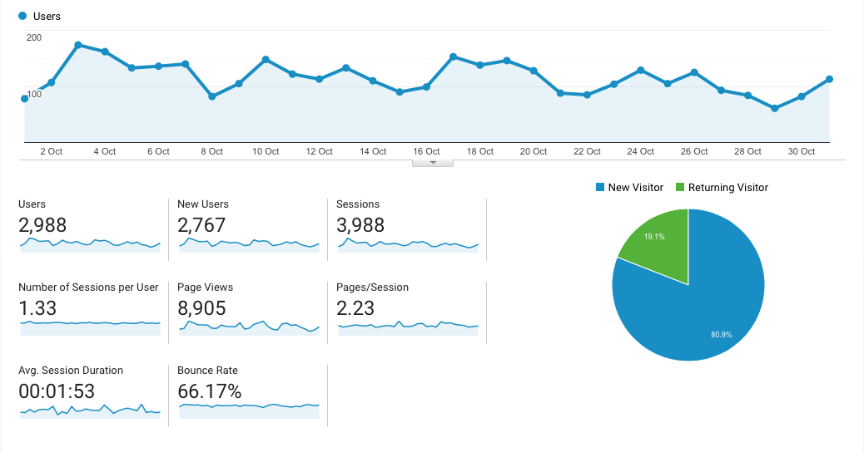
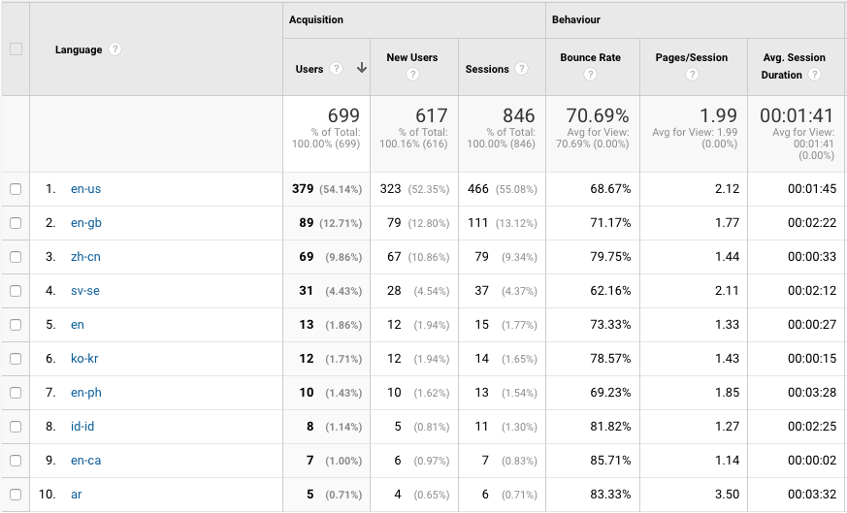
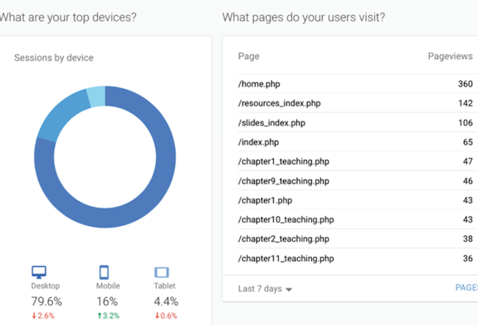
Segment of Google Analytics for Interaction Design 5e website, December 2022

Slide 31
A/B Testing
A type of large-scale experiment
Offers another way to evaluate a website, application or app running on a mobile device
Often used for evaluating changes in design of social media applications
Compares how two groups of users perform on two versions of a design
Can involve thousands of people
May create ethical dilemmas if users don’t know they are part of the test
Care is needed to ensure that other issues are not affecting users’ behavior

Slide 32
PREDICTIVE
MODELS

Slide 33
Predictive Models
Provide a way of evaluating products or designs without directly involving users
Less expensive than testing with users and some kinds of inspections
Usefulness limited to systems with predictable tasks, for example, voicemail systems, smartphones, and dedicated mobile devices
Based on knowledge of expert error-free behavior

Slide 34
Fitts’ Law (1954)
Fitts’ Law predicts that the time to point at an object using a device is a function of the distance from the target object and the object’s size
The further away and the smaller the object, the longer the time to locate it and point to it
It is particularly useful for determining where on a screen to position an object
Fitts’ Law is useful for evaluating systems for which the time to locate an object is important, for example, smartphones, handhelds, and mobile devices

Slide 35
Fitts’ Law:
A Model of Human Motor Performance

Slide 36
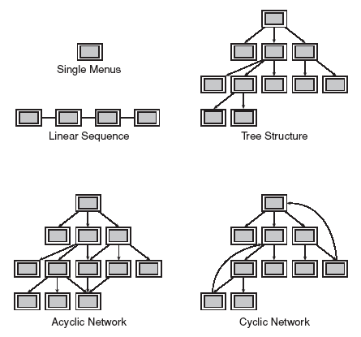
Task-Related Organisation
"The primary goal for menu, form-fillin, and dialog-box designers is to create a sensible, comprehensible, memorable, and convenient organization relevant to the user's task."

Slide 37
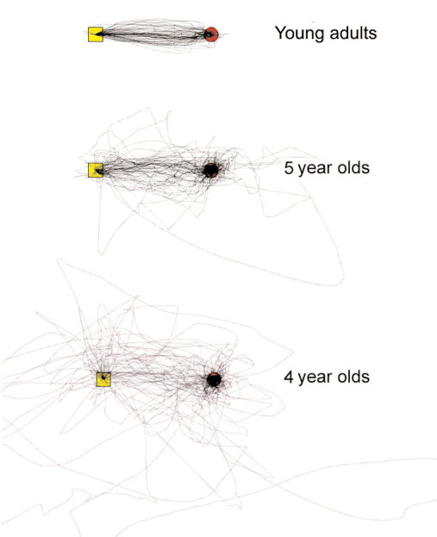
Fitts' Law
Index of difficulty = log₂ (D / W+1)
  D = distance between buttons
  W = target size
Time to point = C1 + C2 (index of difficulty)
C1 and C2 and constants that depend on the device
  C1 = start/stop time in seconds
  C2 = speed of the device
Index of difficulty is log₂ (2*8/1) = log₂ (16) = 4 bits
Notes:
Age has a significant impact on speed and accuracy

Slide 38
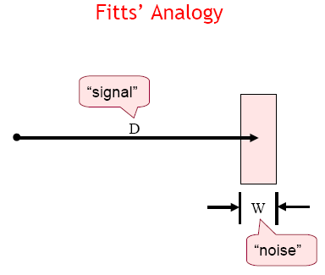

Slide 39
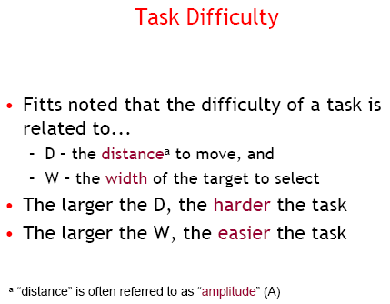

Slide 40
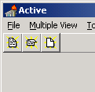
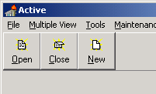
Fitts in Practice
Microsoft Toolbars allow you to either keep or remove the labels under Toolbar buttons
According to Fitts’ Law, which is more efficient?
Source: http://www.asktog.com/columns/022DesignedToGiveFitts.html

Slide 41

Fitts in Practice
You have a toolbar with 16 icons, each with dimensions of 16x16
Without moving the array from the left edge of the screen, or changing the size of the icons, how can you make this more efficient?
Adapted from Hearst, Irani

Slide 42
Fitts in Practice
Answer:
Line up all 16 icons on the left hand edge of the screen
Make sure that each button can be activated up the last pixel on the left hand edge
Why? Because you cannot move your mouse off of the screen, the effective width s is infinite
Adapted from Hearst, Irani

Slide 43
Pie Menus
A circular pop-up menu
  no bounds on selection area
    basically only angle counts
    do want a “dead area” at center
  What are Fitts’ law properties?

Slide 44
Pie Menus
A circular pop-up menu
  no bounds on selection area
    basically only angle counts
    do want a “dead area” at center
  Fitts’ law properties:
    minimum distance to travel
    minimum required accuracy
    very fast
Why don’t we see these much?
    Just not known
    Harder to implement
      particularly drawing labels
      but there are variations that are easier
    Don’t scale past a few items
      No hierarchy

Slide 45
GOMS
Goals - the state the user wants to achieve e.g., find a website.
Operators - the cognitive processes & physical actions needed to attain the goals, e.g., decide which search engine to use.
Methods - the procedures for accomplishing the goals, e.g., drag mouse over field, type in keywords, press the go button.
Selection rules - decide which method to select when there is more than one.

Slide 46
Keystroke Level Model (KLM)
GOMS has also been developed to provide a quantitative model - the keystroke level model.
The keystroke model allows predictions to be made about how long it takes an expert user to perform a task.

Slide 47
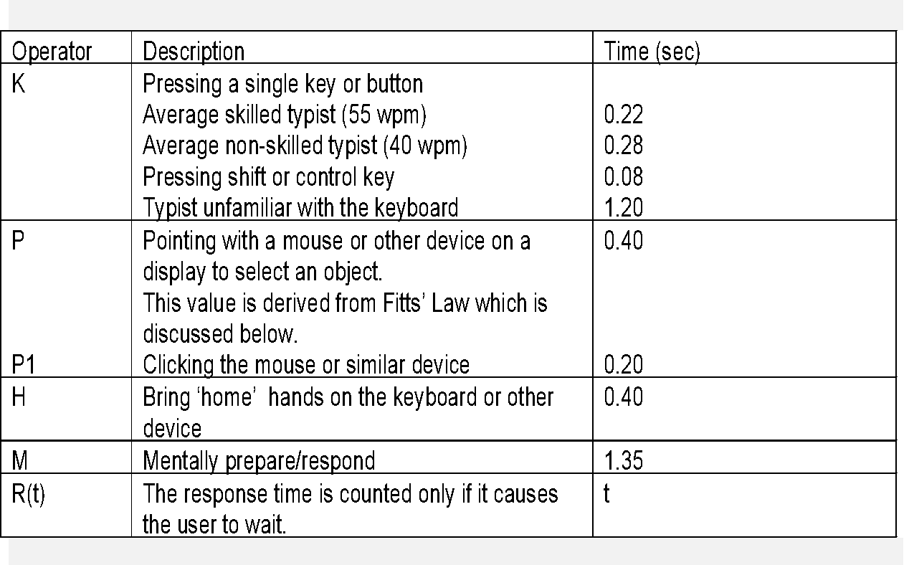
Response Times for Keystroke Level Operators (Card et al., 1983)

Slide 48
Summary
Inspections can be used to evaluate requirements, mockups, functional prototypes, or systems
User testing and heuristic evaluation may reveal different usability problems
Design guidelines can be used to develop heuristics
Web Content Accessibly Guidelines (WCAG) provide guidance for evaluating the accessibility of websites
Walkthroughs are a fine-grained focused method for evaluating small parts of a prototype or product

Slide 49
Summary (Cont.)
Analytics involves collecting data about people’s activity on a website or product to see which parts are used
A/B testing is a form of large-scale experiment
Fitts’ Law can be used to predict expert, error-free performance for clearly defined tasks with limited key presses, for example, to evaluate keypress sequences for handheld devices and the position of objects on a small screen

